Slide 1
Building RAG with PostgreSQL
Pamela Fox, Python Cloud Advocate, @pamelafox
Joshua Johnson, Azure Database for PostgreSQL Product Manager

Slide 2
Agenda
Simple RAG with PostgreSQL
RAG with Azure PostgreSQL solution
AI extensions for Azure PostgreSQL

Slide 3
RAG with PostgreSQL: Getting started

Slide 4




Simple RAG steps
Consider these products:
Summit Climbing Harness¹
Apex Climbing Harness²
Do you sell climbing gear?
[12]:
Name: Summit Climbing Harness Description: Conquer the highest peaks with the Raptor Elite Summit Climbing Harness. This durable and lightweight harness, available in bold red, provides maximum comfort and safety while scaling tricky routes. Price:109.99
…
User
Question
Search
Large Language Model
Notes:
Show RAG-on-postgres

Slide 5
RAG search step: Go hybrid!
pgvector
tsquery
Vector search is best for finding semantically related matches
Keyword search is best for exact matches (proper nouns, numbers, etc)
Hybrid search combines vector search and keyword search, optimally using Reciprocal-Rank-Fusion for merging results and a ML model to re-rank results after
Vector
Keywords
Fusion (RRF)

Slide 6
Simple RAG with hybrid search
Consider these products:
Summit Climbing Harness¹
Apex Climbing Harness²
Do you sell climbing gear?
“Do you sell…”
“Do you sell…”
“Do you sell…”
[[0.0014615238, -0.015594152, -0.0072768144, -0.012787478,…]
[12]:
Name: Summit Climbing Harness Description: Conquer the highest peaks with the Raptor Elite Summit Climbing Harness. This durable and lightweight harness, available in bold red, provides maximum comfort and safety while scaling tricky routes. Price:109.99
…
User
Question
Embedding Model
Hybrid
Search
Large Language Model

Slide 7
Setting up pgvector
Install the pgvector extension:
github.com/pgvector/pgvector
Enable extension:
CREATE EXTENSION IF NOT EXISTS vector;
Tip: Try the extension in the pgvector dev container: github.com/pamelafox/pgvector-playground

Slide 8
Adding a vector column
Choose a vector embedding model
Add a vector embedding column:
ALTER TABLE videos ADD COLUMN embedding vector(256)
Add an index for more efficient searching:
CREATE INDEX ON videos USING hnsw (embedding vector_ip_ops)
Notes:
Add table or links to models, with their names/dimensions

Slide 9
Creating an index for query efficiency
Use either HNSW or IVFflat:
CREATE INDEX ON videos USING hnsw (embedding vector_ip_ops)
Use inner product (vector_ip_ops) on normalized embeddings.
Use cosine product (vector_cosine_ops) otherwise.
Notes:
Add table or links to models, with their names/dimensions

Slide 10
Computing vector embeddings
Python:
string_to_embed = row[0] + " " + row[1]
response = client.embeddings.create(
model="text-embedding-3-small",
input=string_to_embed,
dimensions=256
)
embedding = response.data[0].embedding
cur.execute("UPDATE videos SET embedding = %s WHERE id = %s",
(np.array(embedding), row[0]))
Notes:
Syntax highlight!

Slide 11
Vector search SQL query
SELECT id
FROM videos
ORDER BY embedding <=> %(embedding)s
LIMIT 20
The operator should match the operator used in the index creation.
Use inner product <#> on normalized embeddings.
Use cosine product <=> otherwise.

Slide 12
Full-text search SQL query
SELECT id FROM videos, plainto_tsquery('english', %(query)s) query
WHERE to_tsvector('english', description) @@ query
ORDER BY ts_rank_cd(to_tsvector('english', description), query)
DESC LIMIT 20

Slide 13
Hybrid search query
WITH semantic_search AS (
SELECT id, RANK () OVER (ORDER BY embedding <=> %(embedding)s) AS rank
FROM videos
ORDER BY embedding <=> %(embedding)s
LIMIT 20
),
keyword_search AS (
SELECT id, RANK () OVER (ORDER BY ts_rank_cd(to_tsvector('english', description), query) DESC)
FROM videos, plainto_tsquery('english', %(query)s) query
WHERE to_tsvector('english', description) @@ query
ORDER BY ts_rank_cd(to_tsvector('english', description), query) DESC
LIMIT 20
)
SELECT
COALESCE(semantic_search.id, keyword_search.id) AS id,
COALESCE(1.0 / (%(k)s + semantic_search.rank), 0.0) +
COALESCE(1.0 / (%(k)s + keyword_search.rank), 0.0) AS score
FROM semantic_search
FULL OUTER JOIN keyword_search ON semantic_search.id = keyword_search.id
ORDER BY score DESC
LIMIT 5
https://github.com/pgvector/pgvector-python/blob/master/examples/hybrid_search_rrf.py

Slide 14
Orchestrating a RAG flow with Python
question = "any videos on python?"
cur.execute("SELECT ... ")
results = cur.fetchall()
for result in results:
formatted_results += f"## {result[1]}\n\n{result[2]}\n"
response = client.complete(
messages=[
SystemMessage(content="Answer question according to sources..."),
UserMessage(content=question +
"\n\nSources:\n\n" + formatted_results)],
model="gpt-4o",
temperature=0.3)
Notes:
TOOD

Slide 15
Full RAG with PostgreSQL solution

Slide 16
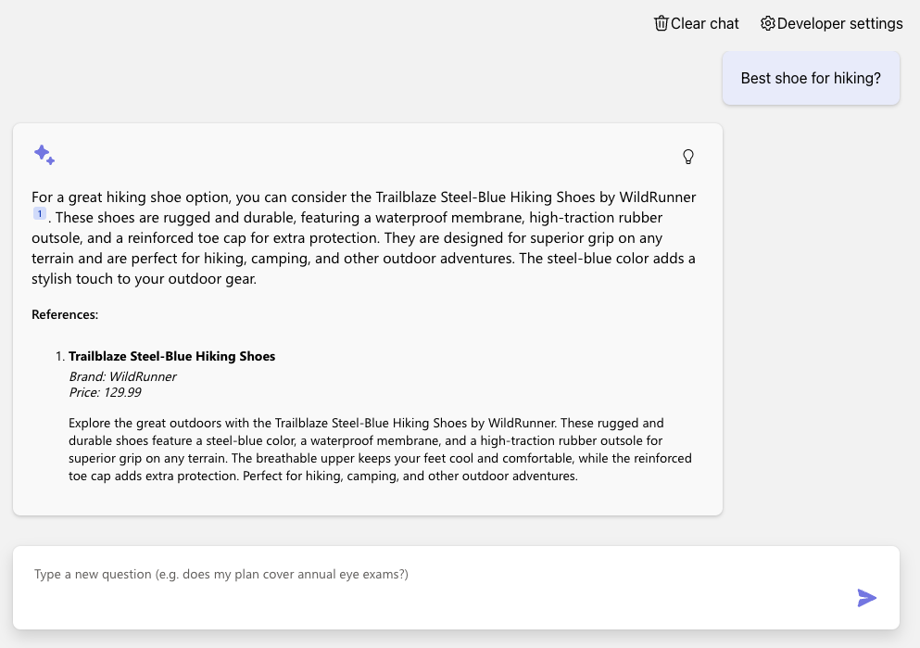
Simple RAG (on PostgreSQL)
Azure OpenAI +
Azure PostgreSQL Flexible Server +
Azure Container Apps
Code:
aka.ms/rag-postgres
Demo:
aka.ms/rag-postgres/demo

Slide 17
Code walkthrough
Typescript frontend
(React, FluentUI)
Python backend
(FastAPI, Uvicorn)
chat.tsx
makeApiRequest()
api.ts
chatApi()
app.py
chat()
simple_rag.py
run()
get_search_query()
compute_text_embedding()
search()
get_messages_from_history()
chat.completions.create()
Notes:
TODO:

Slide 18
Advanced RAG with query re-writing
For great hiking shoes, consider the TrekExtreme Hiking Shoes ¹ or the Trailblaze Steel-Blue Hiking Shoes ²
what's a good shoe for a mountain trale?
mountain trail shoe
[101]:
Name: TrekExtreme Hiking Shoes Price: 135.99
Brand: Raptor Elite
Type: Footwear
Description: The Trek Extreme hiking shoes by Raptor Elite are built to ensure any trail.
…
User
Question
Large Language Model
Search
Large Language Model

Slide 19
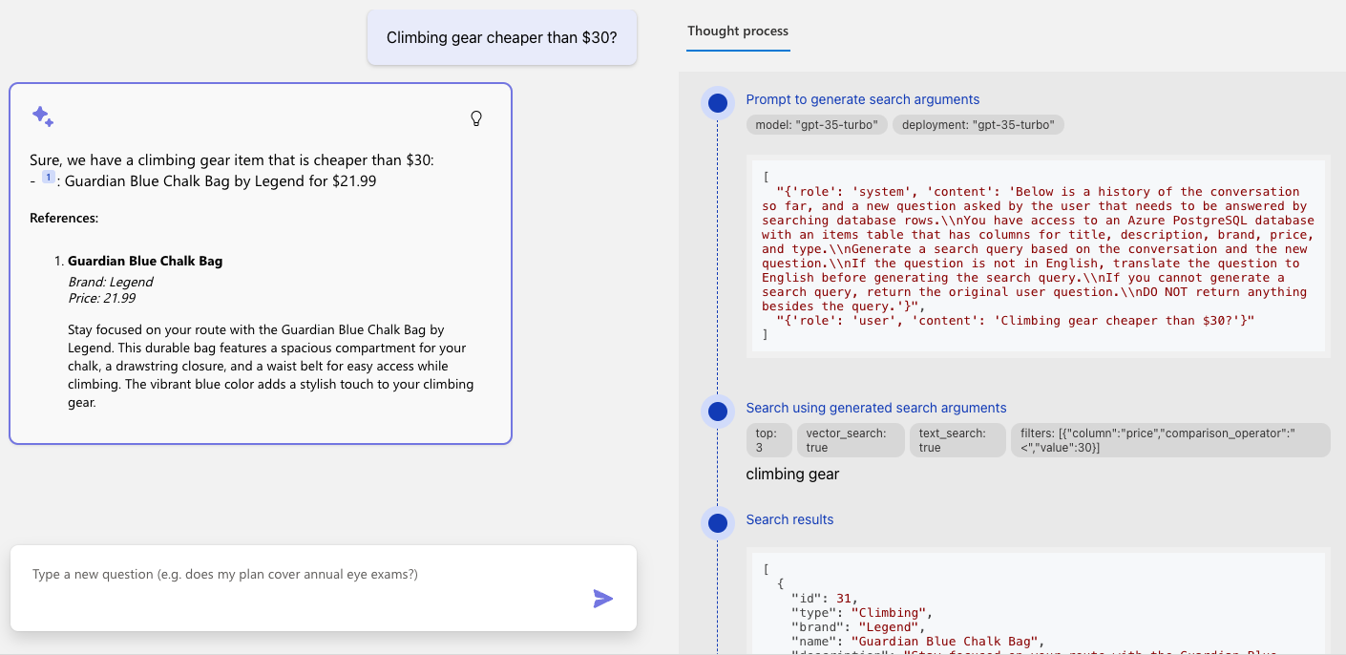
Advanced RAG (on PostgreSQL)

Slide 20
Query rewriting with function calling
Do you sell climbing gear cheaper than $30?
search_database(
"climbing_gear",
{"column": "price",
"operator" : "<",
"value" : "30"
}
)
Large Language Model with function calling
User
Question
Notes:
TODO: live-demo a brand filter

Slide 21
Advanced RAG with query rewriting via function calling
We offer 2 climbing bags for your budget:
SummitStone Chalk Bag ¹
Guardian Blue Chalk Bag ²
Do you sell climbing gear cheaper than $30?
“Do you sell…”
price < 30
“Do you sell…”
“climbing gear”
[12]:
Name: SummitStone Chalk Bag Price:29.99
Brand:Grolltex
Type:Climbing
Description: The SummitStone Chalk Bag in forest green is a must-have for climbers seeking adventure.
…
User
Question
LLM
with function calling
Search
LLM

Slide 22
Code walkthrough
Typescript frontend
(React, FluentUI)
Python backend
(FastAPI, Uvicorn)
chat.tsx
makeApiRequest()
api.ts
chatApi()
app.py
chat()
advanced_rag.py
run()
get_search_query()
compute_text_embedding()
search()
get_messages_from_history()
chat.completions.create()
Notes:
TODO:

Slide 23
Deploying with the Azure Developer CLI
Login to your Azure account:
azd auth login --use-device-code
Create a new azd environment: (to track deployment parameters)
azd env new
Provision resources and deploy app:
azd up

Slide 24



Application architecture on Azure
Azure Database for PostgreSQL
Azure Container Apps
Azure OpenAI

Slide 25
AI extensions for Azure Database for PostgreSQL

Slide 26
Azure Database for PostgreSQL – AI features
Vector data type
Azure AI extension
Integrations
pgvector extension
Native vector data type – store embeddings
Vector indexing for performant searches
Efficient ANN searches within the DB
SQL Interface to Azure OpenAI
Create embeddings from SQL Statements
SQL interface to Azure AI Language services
Invoke Azure ML models from within the DB
LangChain
Semantic Kernel
LlamaIndex
Notes:
FINAL

Slide 27





AI Services integrated into Azure Postgres
Make remote calls directly from PostgreSQL
azure_ai extension
Exceptional simplicity out of the box
Azure OpenAI
Azure AI Language Services
Azure AI Translator
Azure Machine Learning
Enables developers to rapidly adopt new AI capabilities in their solution without complex re-architecture or refactoring
Azure OpenAI
Azure Database for PostgreSQL
Azure AI
Language Services
Azure AI Translator
Azure Machine Learning
Notes:
Let's say you have an application with Data on Postgres, and want to introduce vectors, embeddings, Gen AI or AI functionality
Normally you would have to do that from the App stack, Application code modified to go talk to Azure Open AI, and other AI services
We have created a first party extension which allows you to do that from the database itself, greatly simplifying this experience.
App Talks to the database, Install the Azure AI extension AND vector extension and off you go
Call a UDF< get embeddings from Azure OpenAI
Access to Azure AI language services from within SQL

Slide 28



Vector Generation
Unique Remote + In-Database Embedding Models
Remote Embedding Models
SELECT * FROM <table>
ORDER BY
database_description <->
azure_openai.create_embeddings(
‘text-embedding-ada-002’,
‘Databases with vector support’)
“Databases with vector support”
0.001238432, …
Application
Azure Database for PostgreSQL
Azure OpenAI Embedding Models
In-Database Embedding Models (Preview)
SELECT * FROM <table>
ORDER BY
recipe_embedding <#>
azure_local_ai.create_embeddings(
‘multilingual-e5-small:v1’,
‘Databases with vector support’)
“Databases with vector support”
Local Embedding Models
(Running in Postgres VM)
0.001238432, …
Application
Azure Database for PostgreSQL
Notes:
How does this Azure AI extension actually work?
Let’s take an example invoking Azure Open AI to create an embedding.
Your application issues a statement, it connects to Azure Database for PostgreSQL flexible server, sends in a SELECT query which passes a “SEARCH PHRASE”. However, first in order to have an accurate search we need to create an embedding and compare with stored embeddings.
How we do this is. The PG Flexible Server in-turn sends a call to Azure OpenAI and passes the “SEARCH PHRASE” input and as a result the service returns a VECTOR that is stored in the vector extension, with the vector data type within the database.
Further, creation of vector indexes on top of vector column enables a much efficient similarity searches, which you won’t get when using a third-party vector database.
Result is of-course is based on the query is returned to the application
Example: Here you input a text query “high protein recipes”, it can be converted into a vector via Azure_AI extension. Next pgvector can be used to find other vectors that are closest to it in terms of vector space. This corresponds to finding text entries in the database that are semantically similar to the input query.

Slide 29
In-Database Embedding Models
Low-latency embedding creation for OLTP workloads
Data Privacy, data doesn’t leave database
Lower latency and higher throughput
Cost predictability

Slide 30
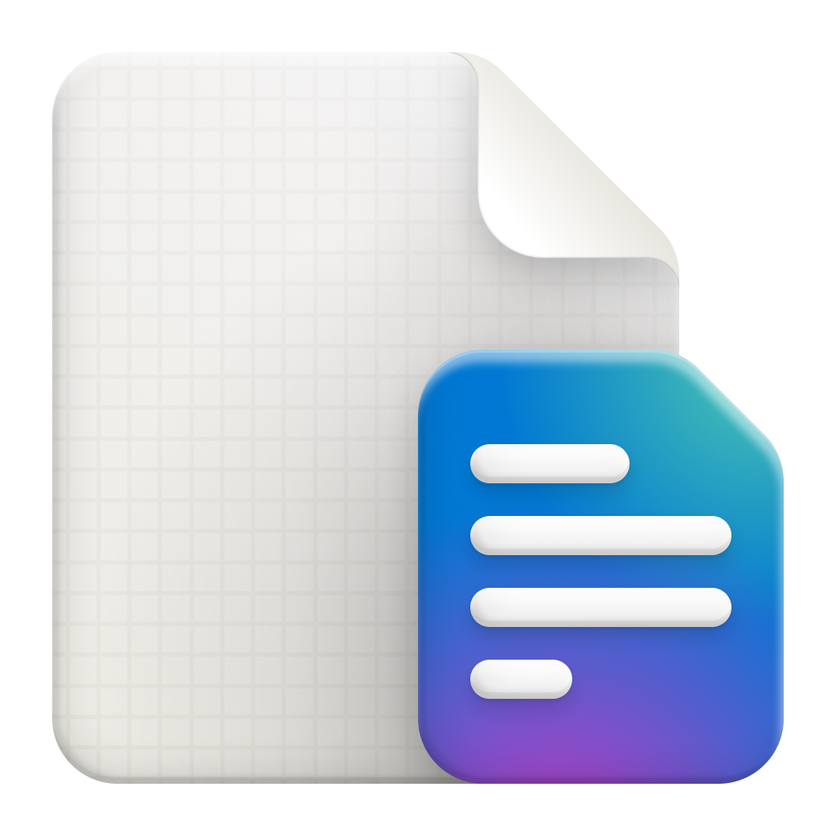



RAG Pattern with Azure Database for PostgreSQL
Unstructured Data
Embedding Model
Vector Database
Large Language Models
a
Azure OpenAI
Azure OpenAI
Chunks
Vectors
Azure ML
Azure ML
Vector data type & Indexes
Get answers
Create Embedding
Similarity search
Get context
Prompt template: Answer the question with given context
Get answers
Question
Does my vision insurance cover Lasik?
5.1.1 Eligibility for LASIK Coverage
The insurance plan provides coverage for LASIK for:
18 or older with fully developed eyes
Refractive stability history for 12 months
Treatable range of refractive errors.
RAG (Context)
Your insurance covers LASIK with some stipulations
No RAG
LASIK is not typically considered medically necessary, and most health insurance plans do not cover the entire expense of the surgery

Slide 31
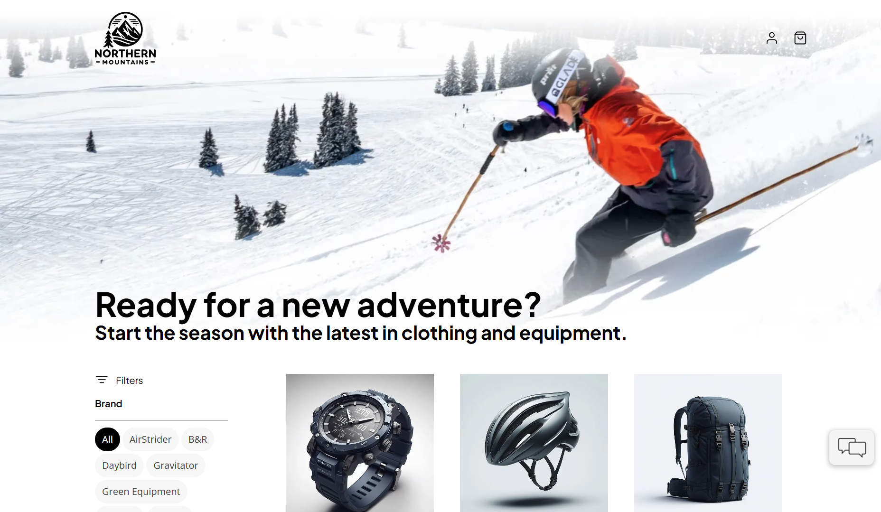
eShop – Powered by Azure DB for PostgreSQL
eShop with chat assistant
.Net Aspire
Entity Framework Core
Semantic Kernel and Azure OpenAI
Azure DB for PostgreSQL
Extensions:
azure_ai
pgvector

Slide 32
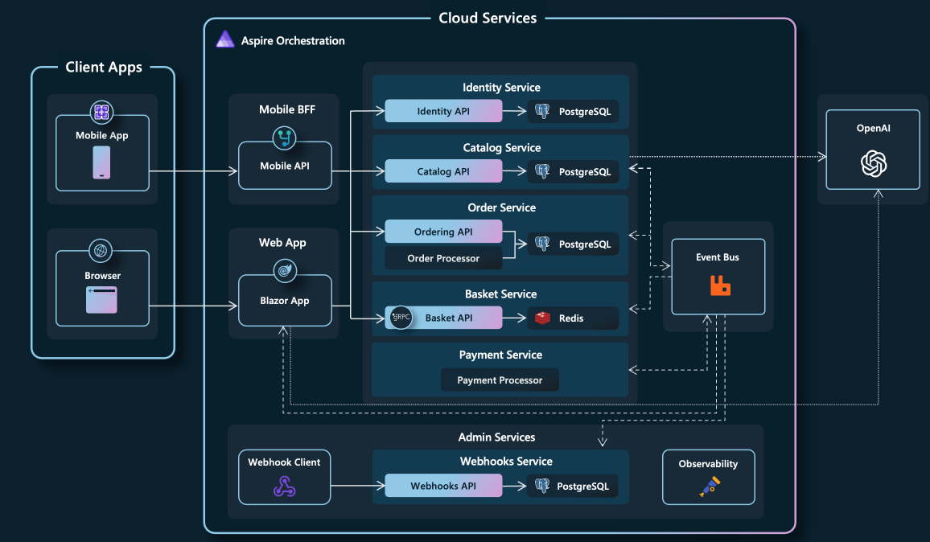
Azure-Samples/eShopOnAzure
Notes:
Here we have an ecommerce application for e-retailer Northern Mountains, where we can find the gear for our next winter adventure.
This application takes advantage of .NET Aspire, a cloud-native stack for building distributed apps with .NET.
.NET Aspire is designed to help you with:
Orchestration: .NET Aspire provides features for running and connecting multi-project applications and their dependencies for local development environments.
Components: .NET Aspire components are NuGet packages for commonly used services, such as Redis or Postgres, with standardized interfaces ensuring they connect consistently and seamlessly with your app.
Tooling: .NET Aspire comes with project templates and tooling experiences for Visual Studio and the dotnet CLI help you create and interact with .NET Aspire apps.
Discuss architecture, locally deployed for testing, azd up / azd deploy to deploy this application to our connected Azure Subscription.
This application is a perfect example of how readily Azure Database for PostgreSQL integrates with multiple frameworks, languages, supports open-source Postgres Community extensions.
.Net Aspire
Entity Framework Core
Semantic Kernel
Azure OpenAI
npgsql/efcore.pg: Entity Framework Core provider for PostgreSQL (github.com)
Npgsql Entity Framework Core Provider | Npgsql Documentation

Slide 33
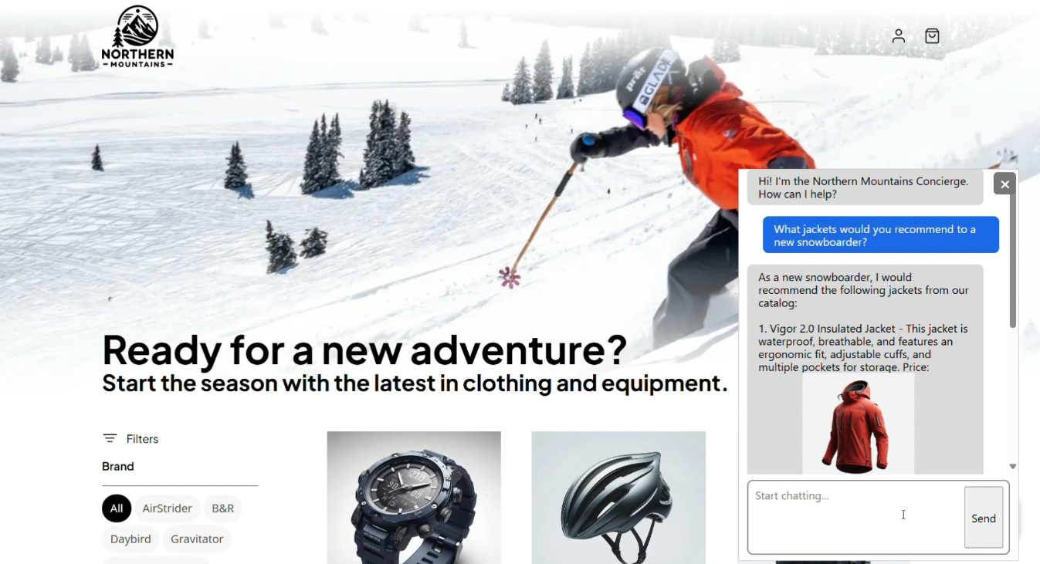
eShop experience

Slide 34
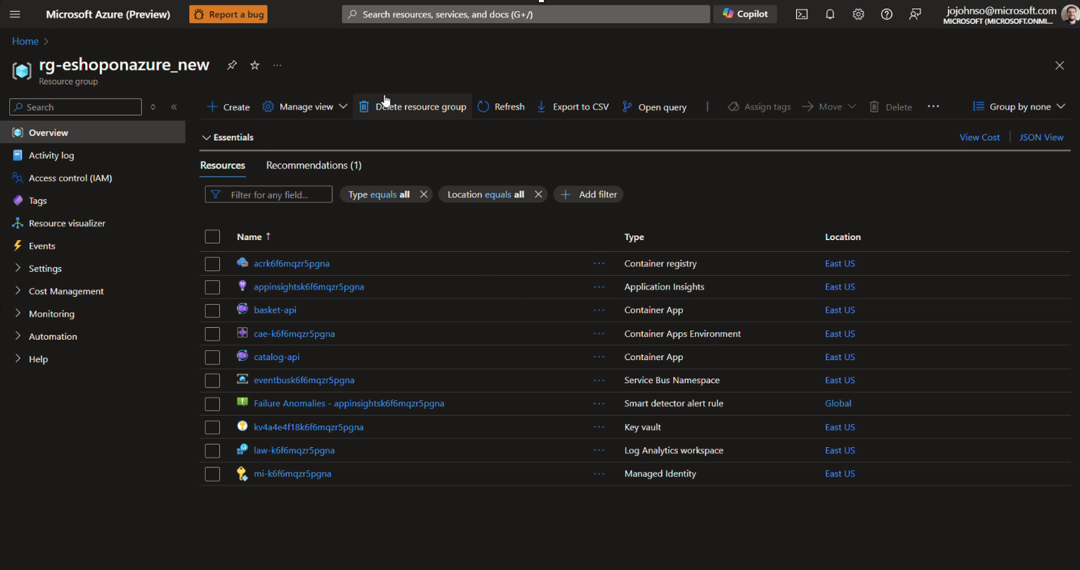
eShop architecture

Slide 35
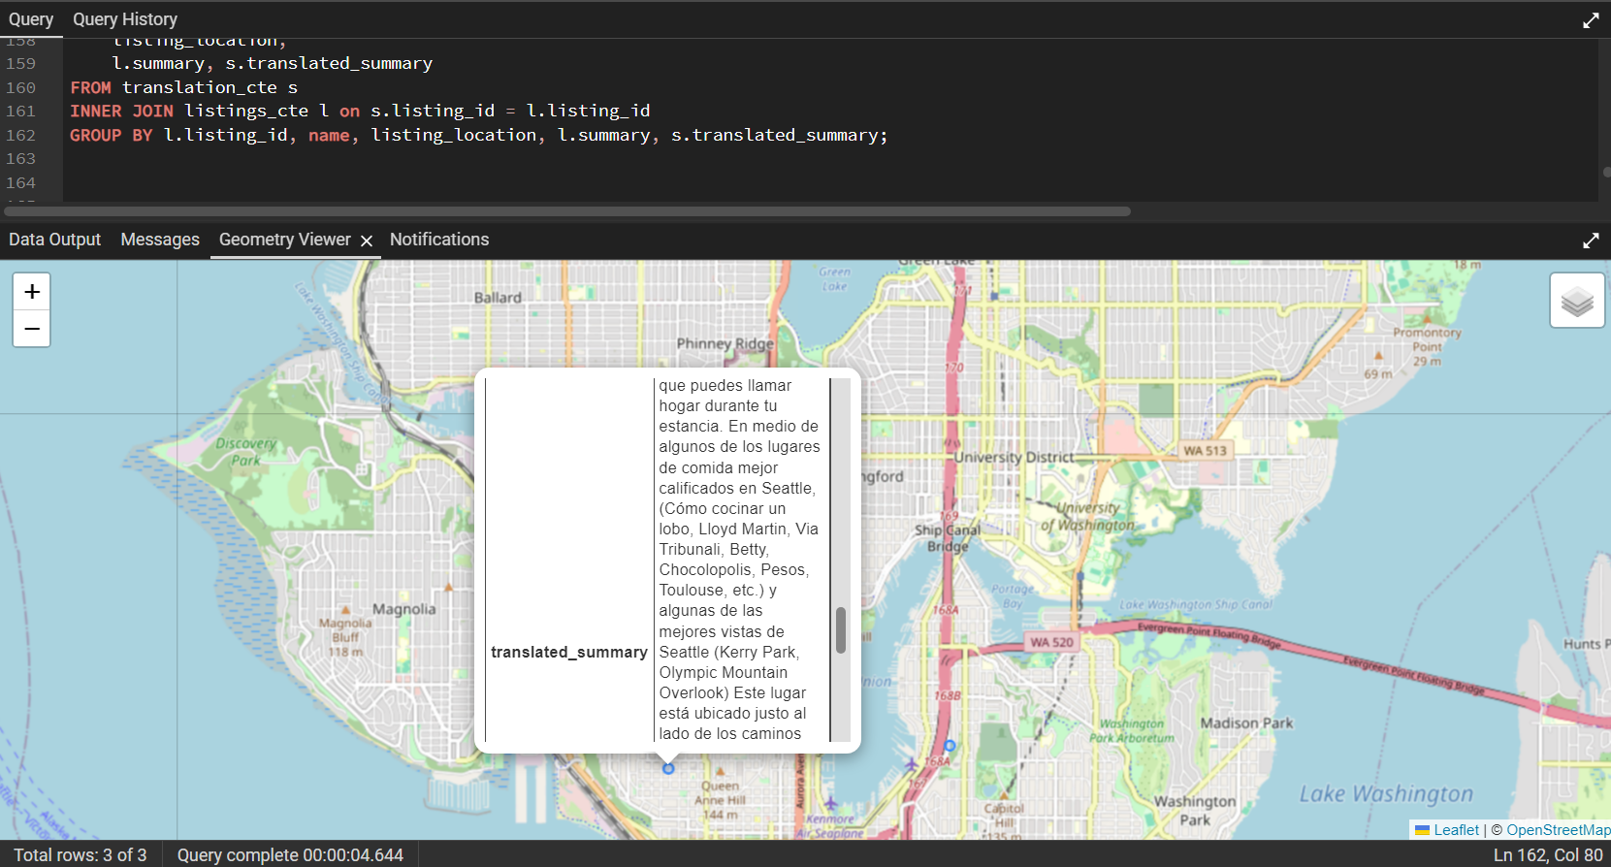
Real-time translation of listing summaries
Hybrid search with real-time translation.
Combining,
Vector search
Geospatial data
Azure AI Services

Slide 36
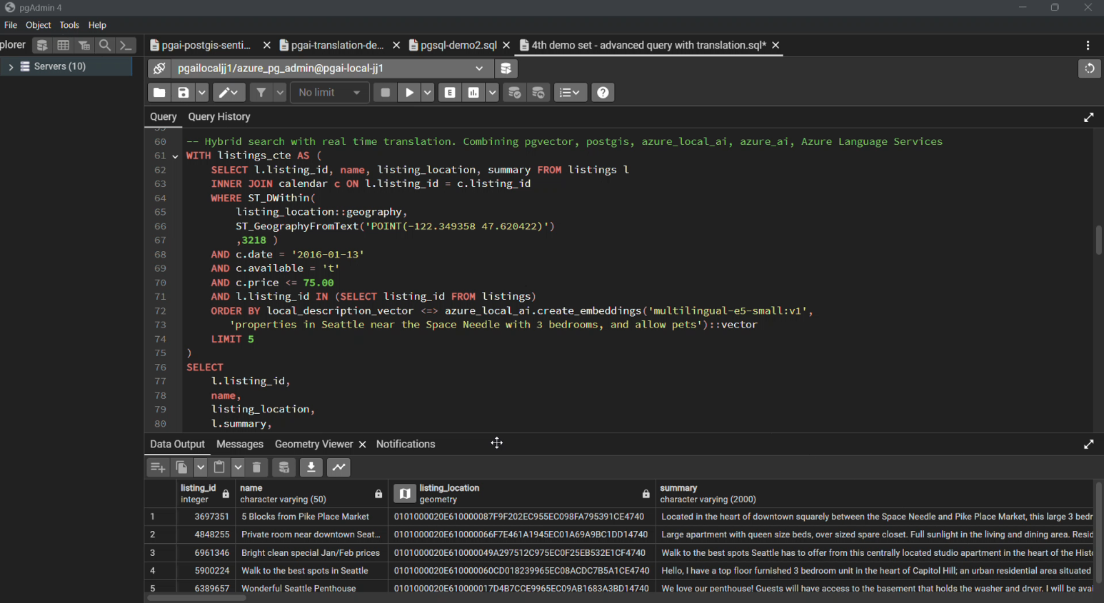
Real-time translation of listing summaries
https://gist.github.com/pamelafox/07cac5bb6558701c17315858d8731924

